Slide 1
Introduction to Neural Networks

Slide 2
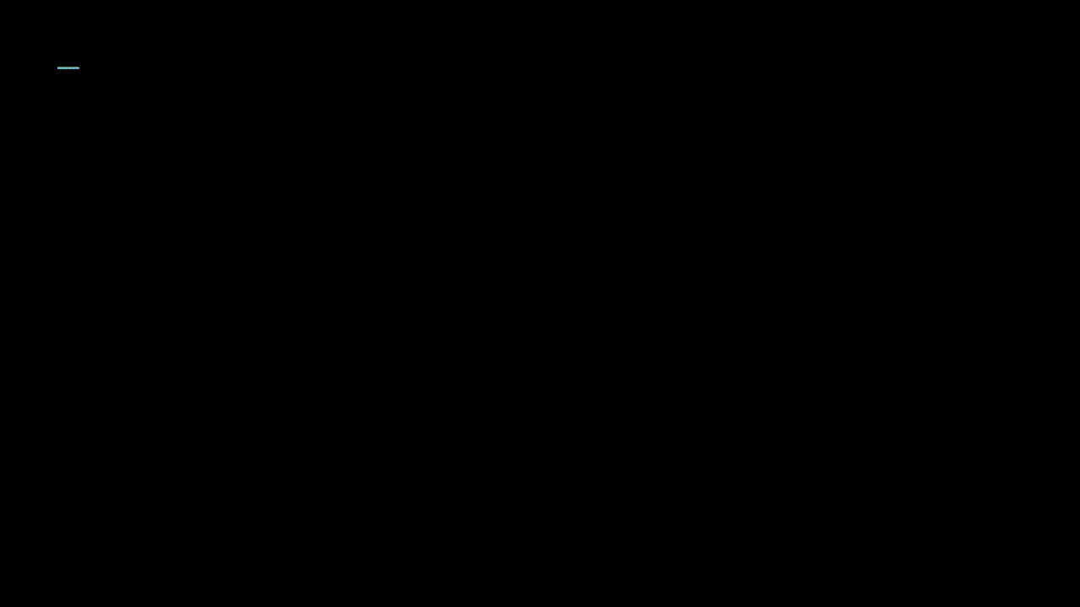
Why neural network ?
Try writing a traditional code that takes the image on the right as an input and gives 3 as an output.
Hard ?

Slide 3
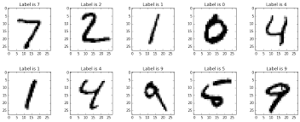
Now what about 10 digits ?

Slide 4
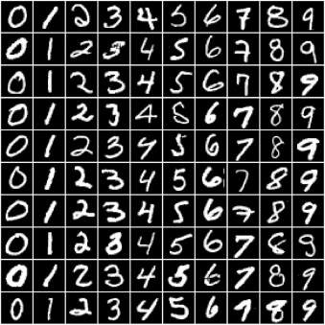
Now 100 images with different pixel values ?

Slide 5

Now ? These are just a few variations of 2

Slide 6
Solution – Neural Networks

Slide 7


Slide 8


Slide 9
Neural
Network
What are neurons ?
How are the connected?
*We will get to a more traditional definition later

Slide 10
Neurons

Slide 12
Input layer and activation

Slide 13
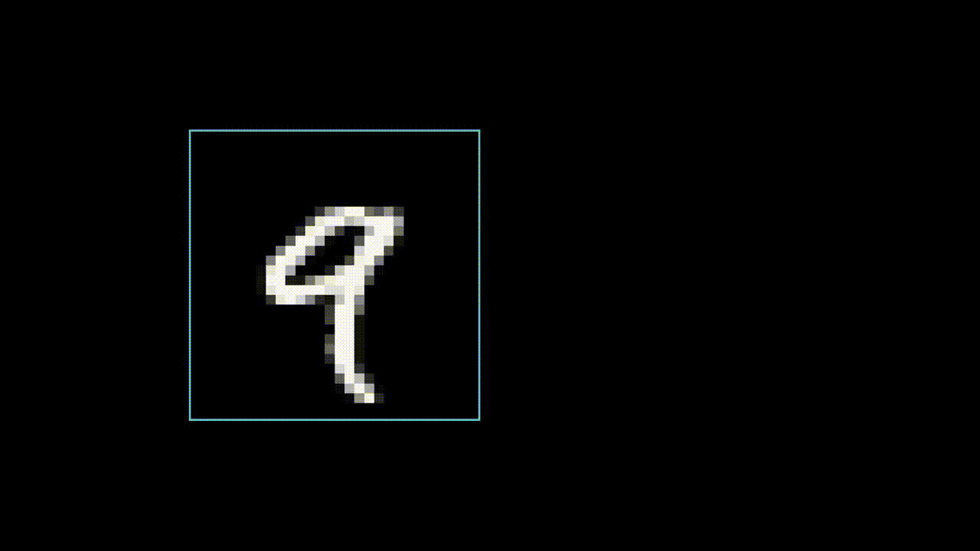

Slide 14
Output layer and Hidden Layer

Slide 16
Neural Network

Slide 18
What are the layers doing ?

Slide 21
Weights

Slide 23
Activation function and Bias

Slide 25
Updated definition of neurons

Slide 27
Training Process

Slide 29
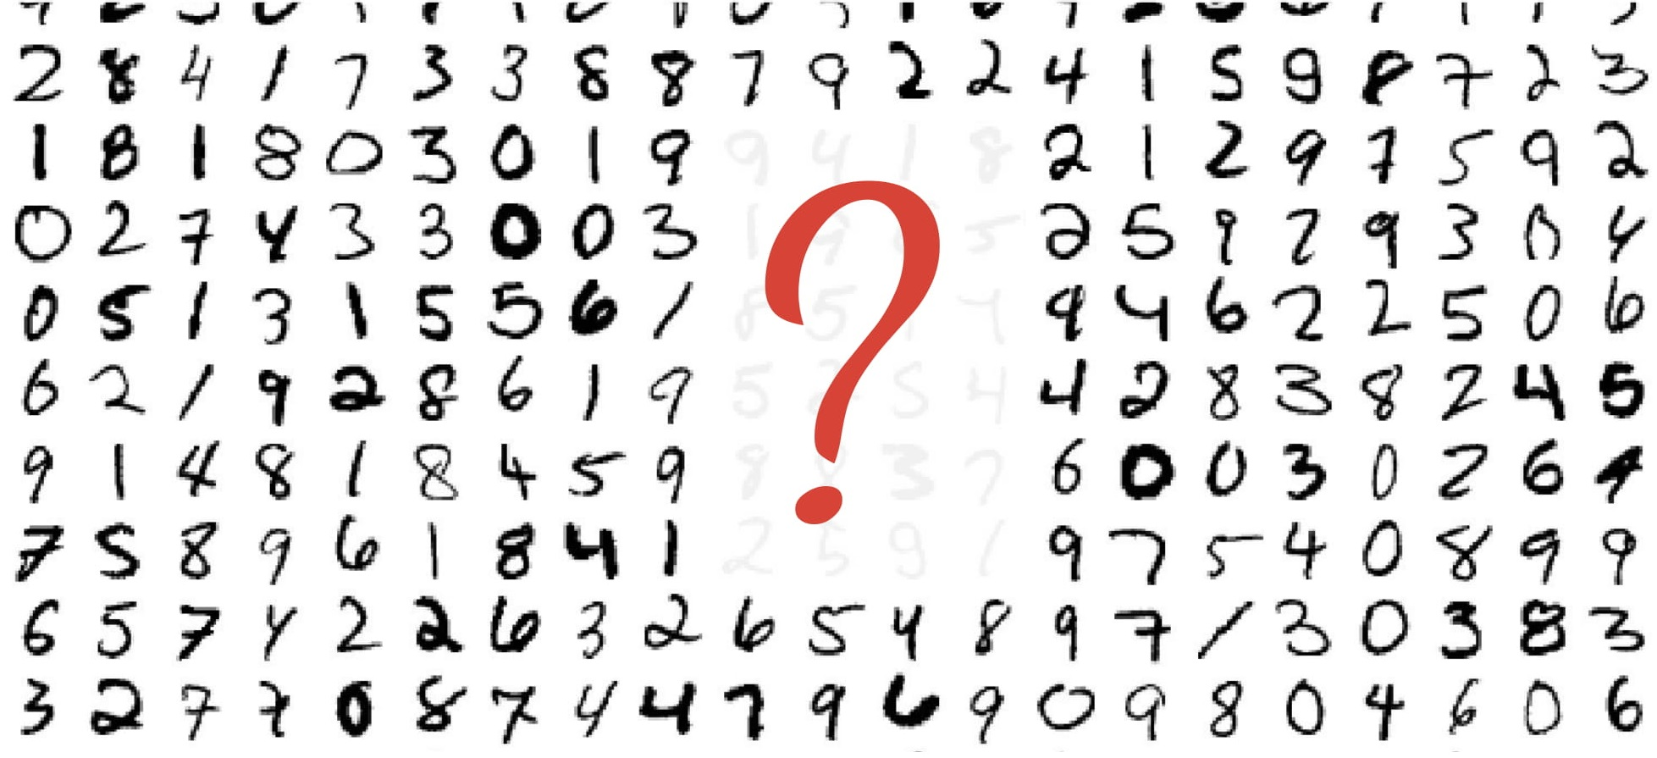
Handwritten digits classification

Slide 30
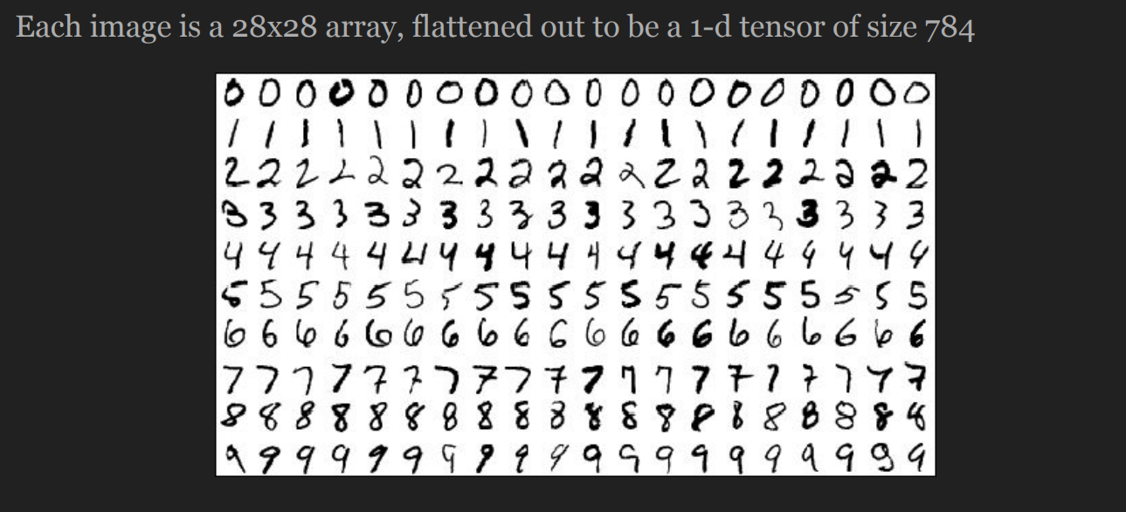
MNIST dataset

Slide 31
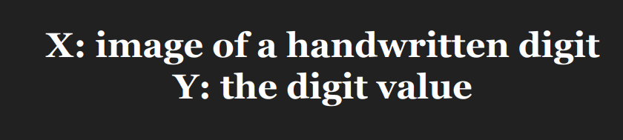
MNSIT

Slide 32
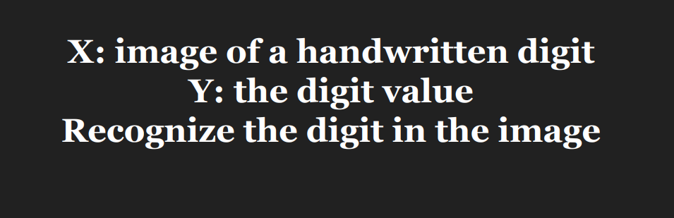
Goal ?

Slide 33
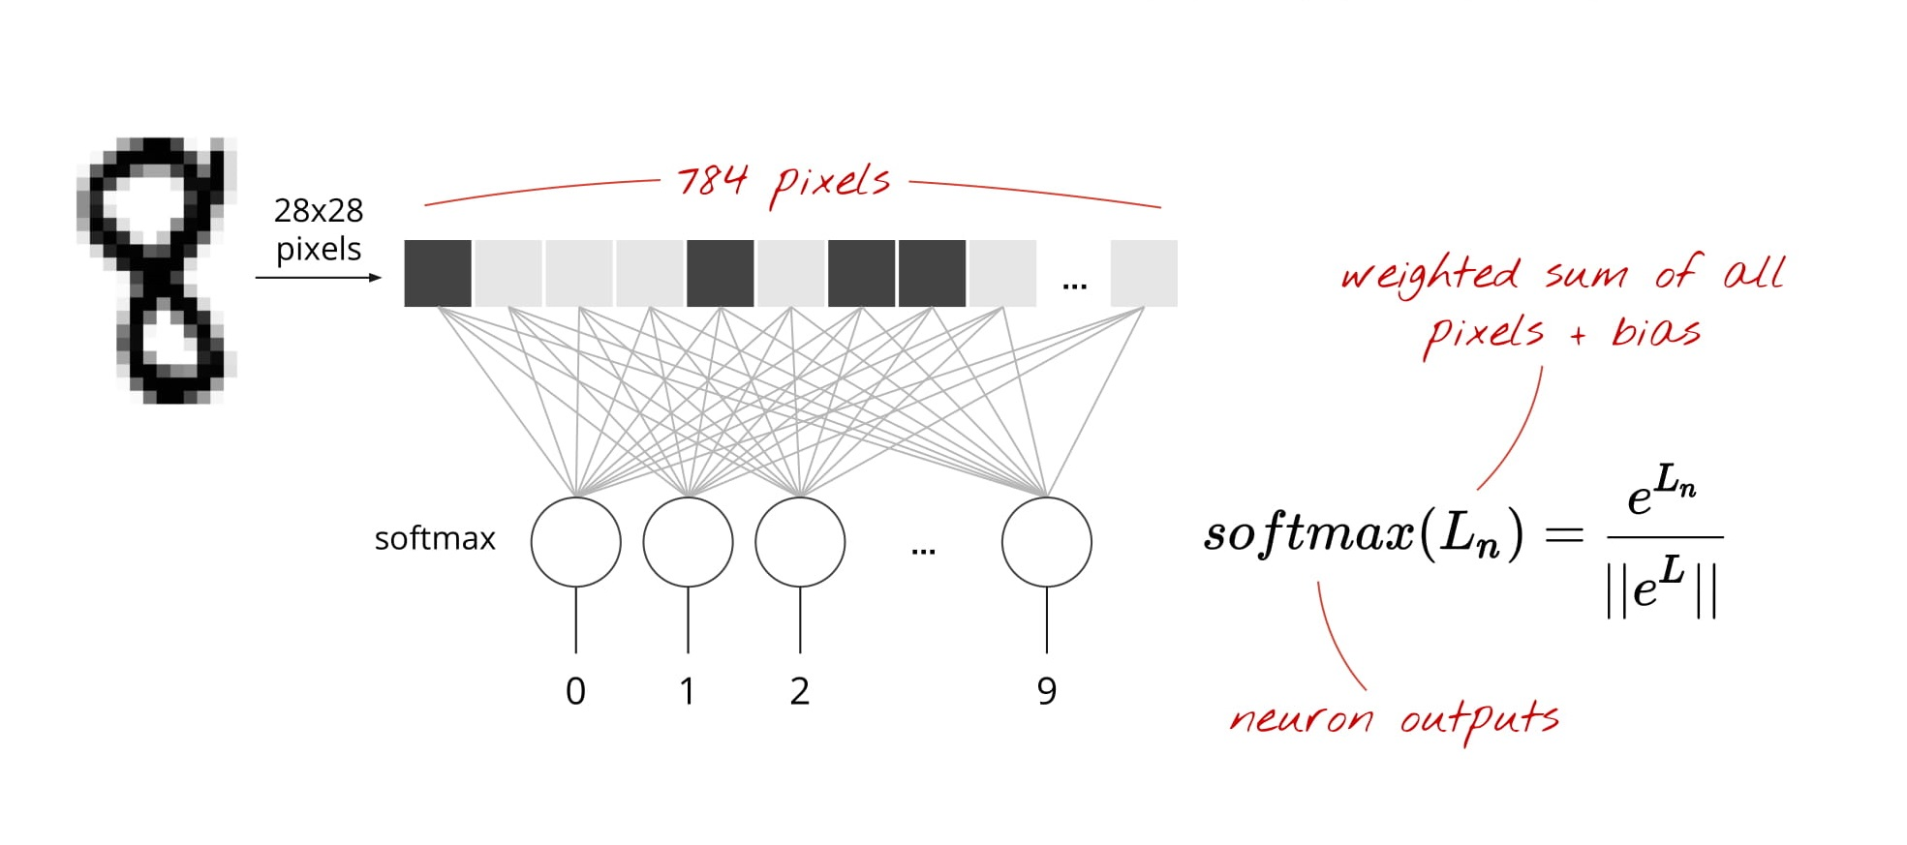

Slide 34
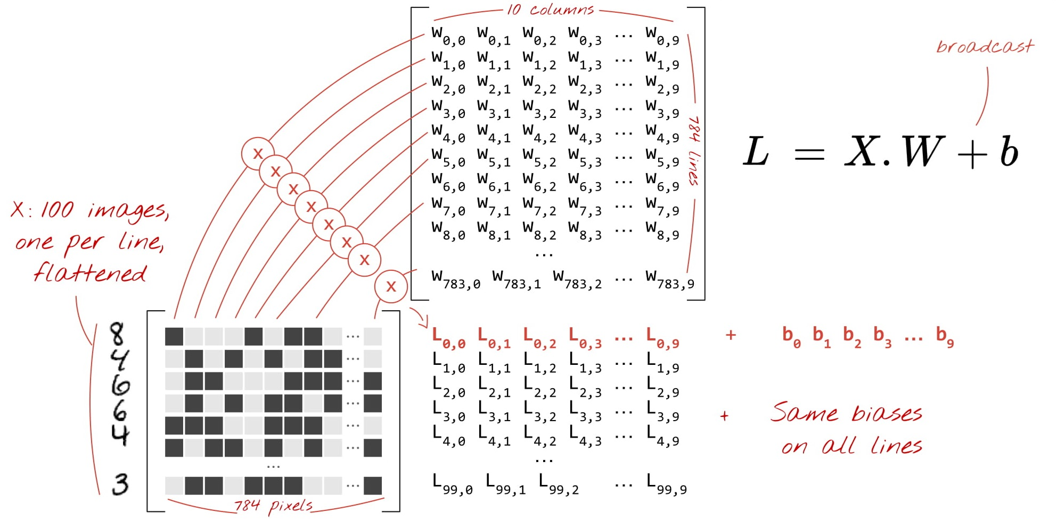

Slide 35
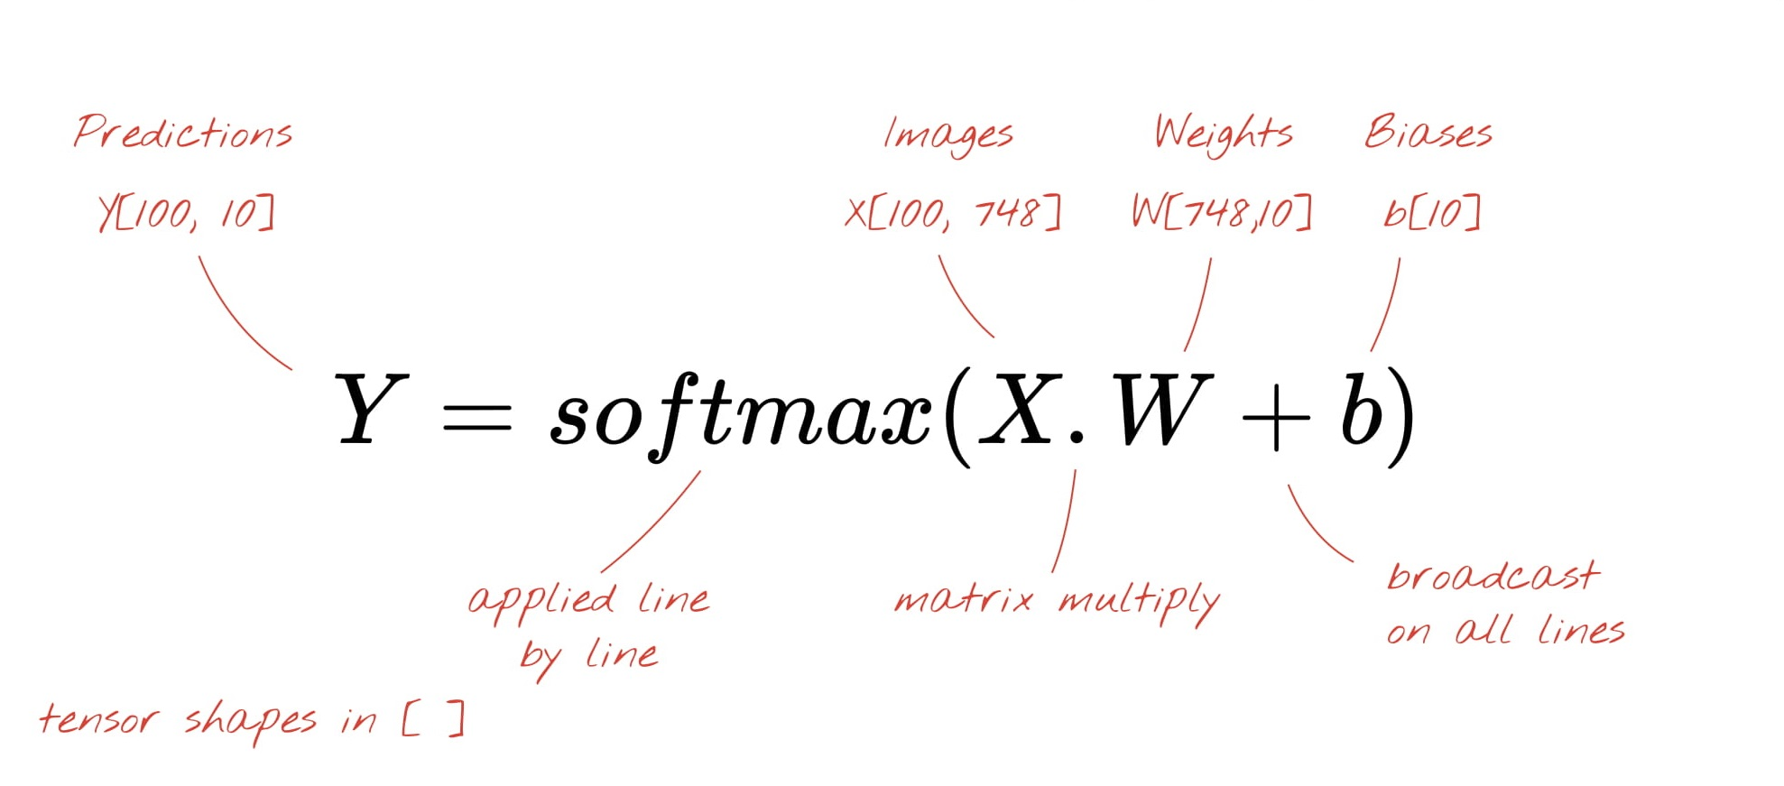

Slide 36
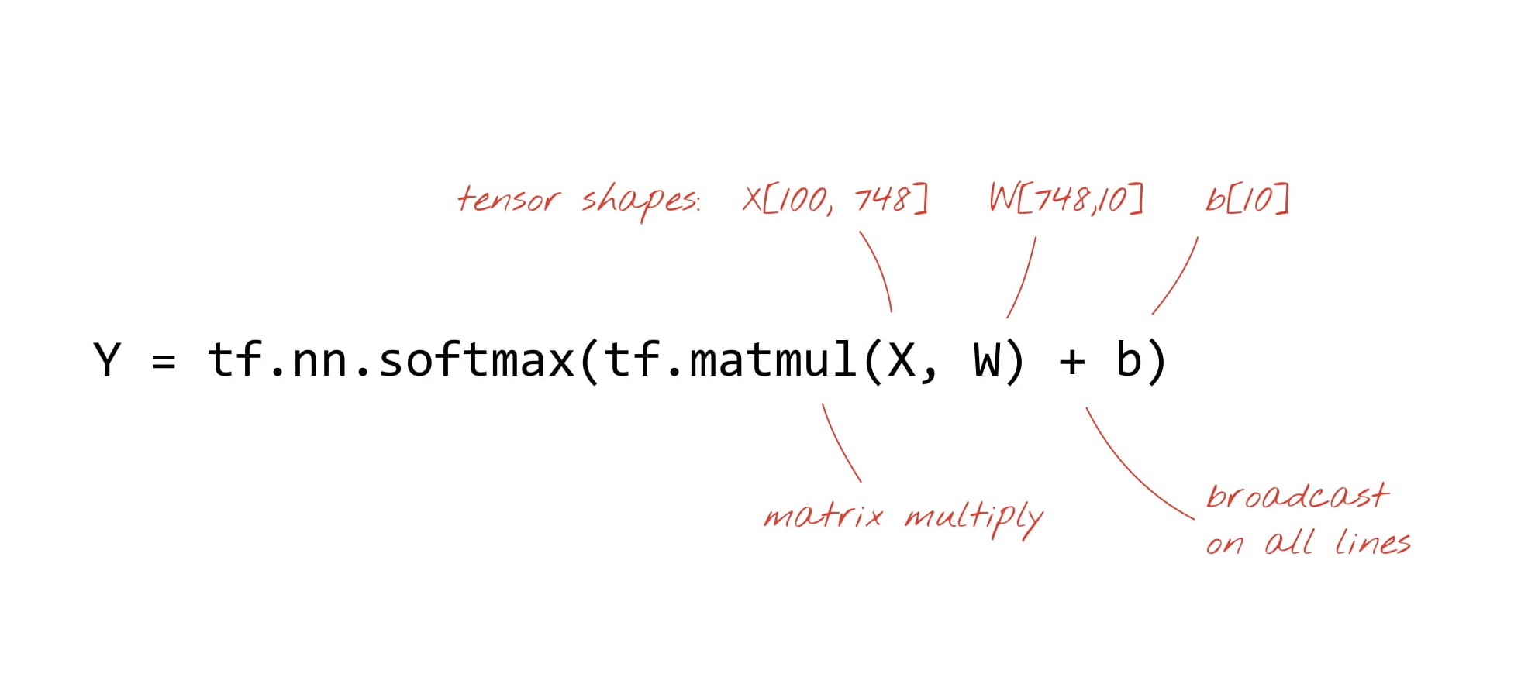

Slide 37
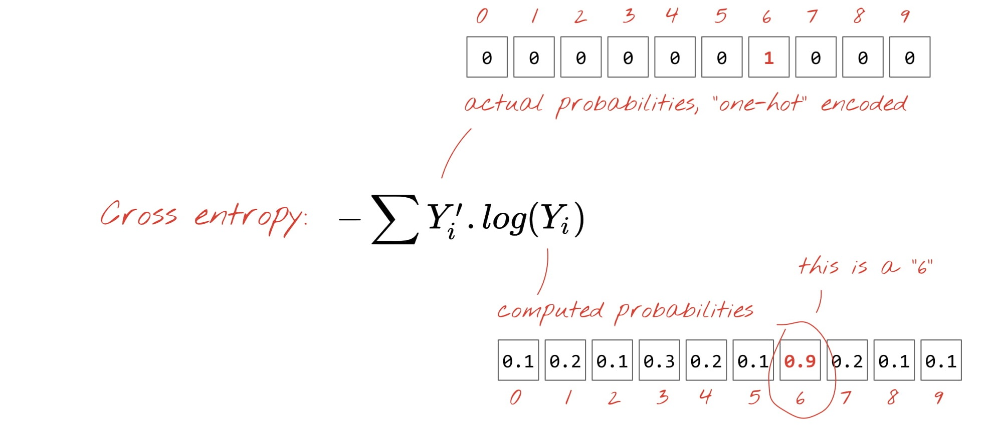

Slide 38
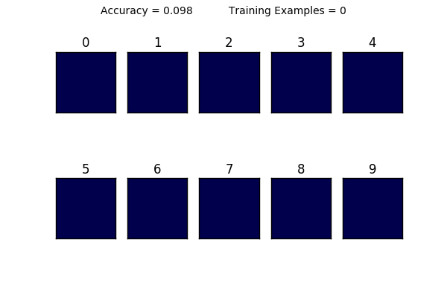

Slide 39

Coding Time !
C:\Users\... > jupyter notebook

Slide 40
Appendix

Slide 41
Neural networks Definition
Neural networks are mathematical and computational abstractions of biological processes that take place in the brain. Specifically, they loosely mimic the “firing” of interconnected neutrons in response to stimuli — such as new incoming information.
Artificial Neural Networks have generated a lot of excitement in Machine Learning research and industry, thanks to many breakthrough results in speech recognition, computer vision and text processing.
Neural networks work by computing weighted summations of input vectors that are then passed through non-linear activation functions, thereby creating a mapping from input to output via a non-linear transformation layer.
The weights (represented by neutrons) in the transformation, or hidden, layer are iteratively adjusted such that they come to represent relationships in the data that map inputs to outputs.

Slide 42
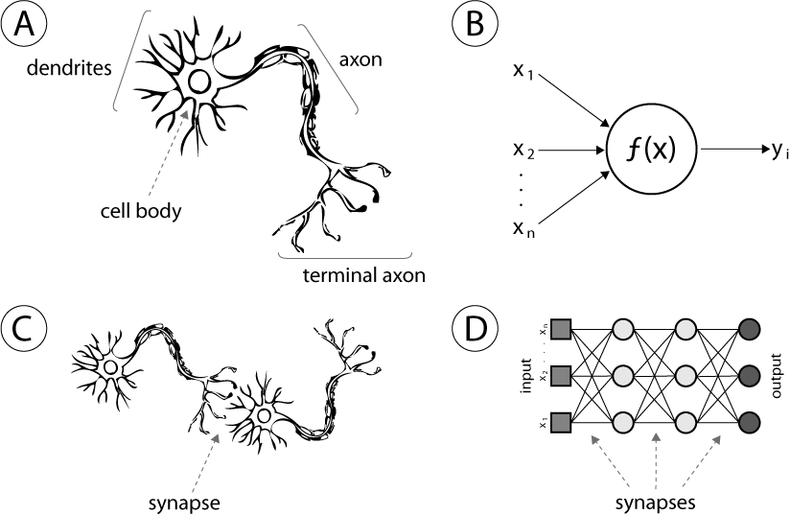
Comparing ANN to Biological Neuron
Human neuron
Artificial neuron or hidden unity;
Biological synapse
ANN synapses

Slide 43
Types of Neural Networks

Slide 44


Slide 45
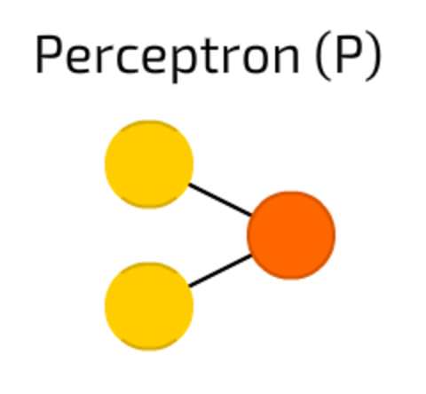
Perceptron
The simplest and oldest model of Neuron, as we know it. Takes some inputs, sums them up, applies activation function and passes them to output layer.

Slide 46
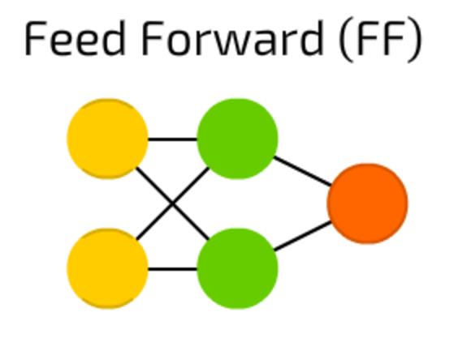
Feed forward neural networks
it follows the following rules:
all nodes are fully connected
activation flows from input layer to output, without back loops
there is one layer between input and output (hidden layer)
In most cases this type of networks is trained using Backpropagation method.

Slide 47
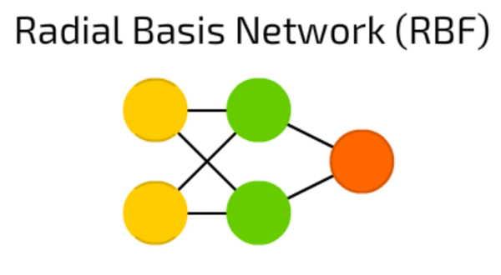
RBF neural networks
FF (feed forward) NNs, that use radial basis function as activation function instead of logistic function.
Logistic function map some arbitrary value to a 0…1 range, answering a “yes or no” question. It is good for classification and decision making systems, but works bad for continuous values.
Contrary, radial basis functions answer the question “how far are we from the target”? This is perfect for function approximation, and machine control (as a replacement of PID controllers, for example).

Slide 48
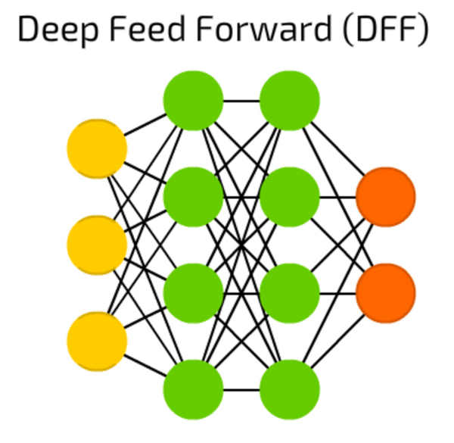
DFF neural networks
These are just FF NNs, but with more than one hidden layer.
When training a traditional FF, we pass only a small amount of error to previous layer. Because of that stacking more layers led to exponential growth of training times, making DFFs quite impractical.
Only in early 00s we developed a bunch of approaches that allowed to train DFFs effectively; now they form a core of modern Machine Learning systems, covering the same purposes as FFs, but with much better results.

Slide 49
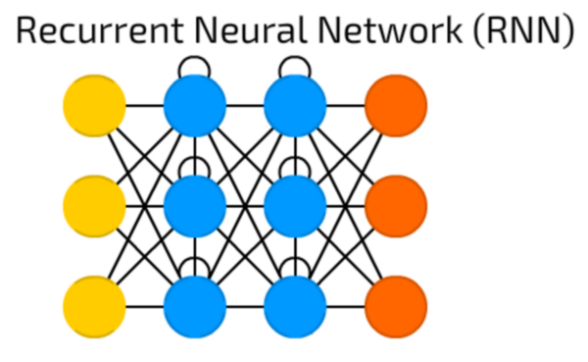
Recurrent Neural Networks
Introduce different type of cells — Recurrent cells. Apart from that, it was like common FNN.
This type of NNs is mainly used then context is important — when decisions from past iterations or samples can influence current ones.
The most common examples of such contexts are texts — a word can be analysed only in context of previous words or sentences.

Slide 50
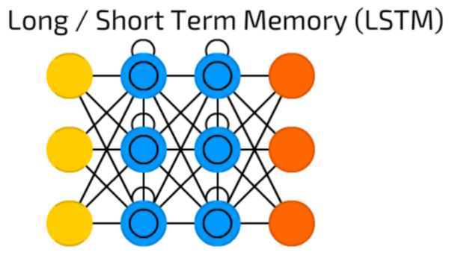
Long short-term memory
This type introduces a memory cell, a special cell that can process data when data have time gaps.
RNNs can process texts by “keeping in mind” ten previous words, and LSTM networks can process video frame “keeping in mind” something that happened many frames ago.
LSTM networks are also widely used for writing and speech recognition.
Memory cells are actually composed of a couple of elements — called gates, that are recurrent and control how information is being remembered and forgotten.

Slide 51
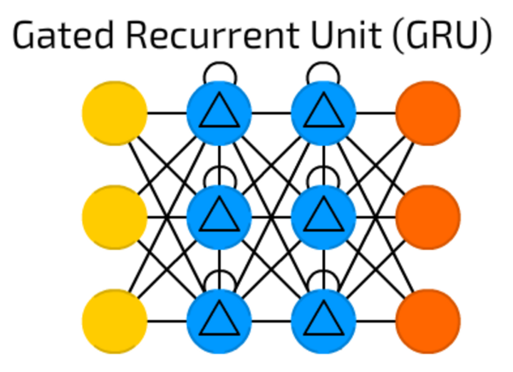
Gated Recurrent Unit
GRUs are LSTMs with different gating. Period.
Sounds simple, but lack of output gate makes it easier to repeat the same output for a concrete input multiple times, and are currently used the most in sound (music) and speech synthesis.
The actual composition, though, is a bit different: all LSTM gates are combined into so-called update gate, and reset gate is closely tied to input.
They are less resource consuming than LSTMs and almost the same effective.

Slide 52
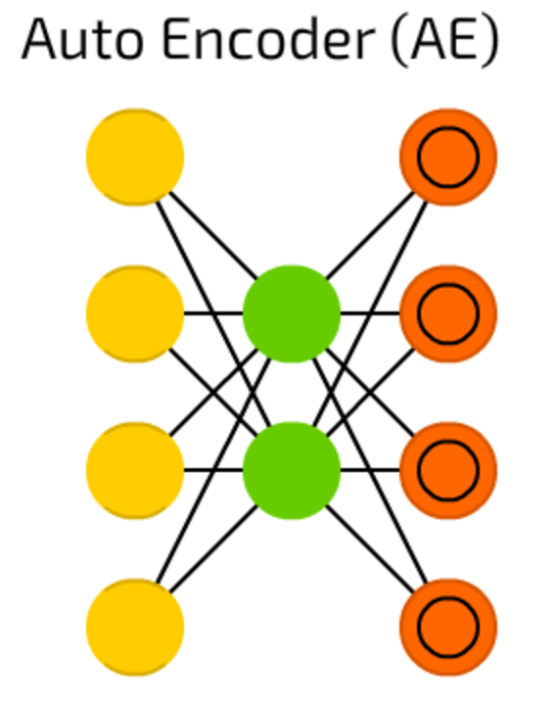
Auto encoders
Autoencoders are used for classification, clustering and feature compression.
When you train FF neural networks for classification you mostly must feed then X examples in Y categories, and expect one of Y output cells to be activated. This is called “supervised learning”.
AEs, on the other hand, can be trained without supervision. Their structure — when number of hidden cells is smaller than number of input cells (and number of output cells equals number of input cells), and when the AE is trained the way the output is as close to input as possible, forces AEs to generalise data and search for common patterns.

Slide 53
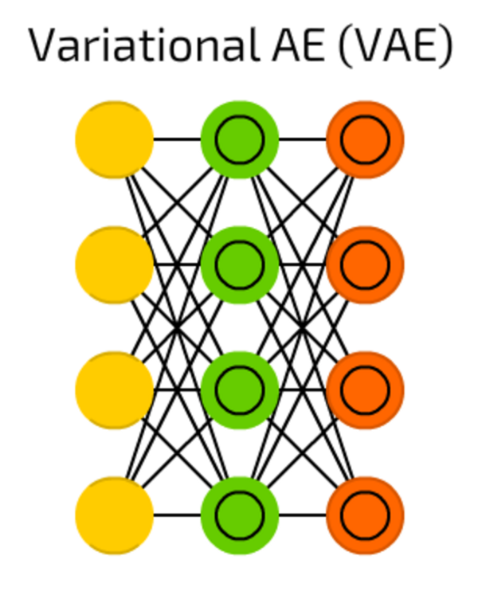
Variational AE
VAEs, comparing to AE, compress probabilities instead of features.
Despite that simple change, when AEs answer the question “how can we generalise data?”, VAEs answer the question “how strong is a connection between two events? should we distribute error between the two events or they are completely independent?”.

Slide 54
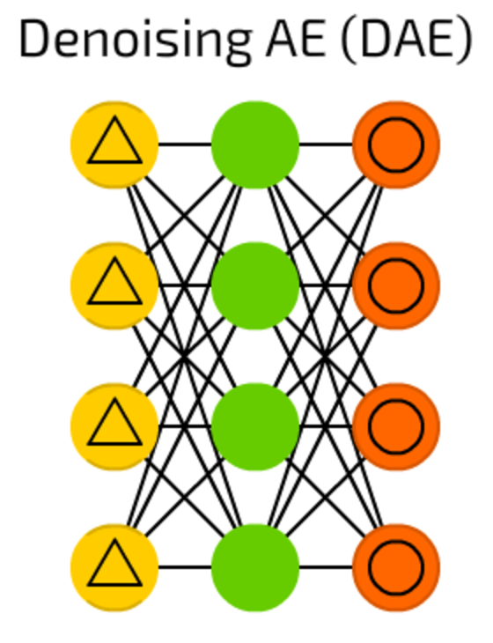
Denoising AE
AEs sometimes, instead of finding the most robust features, just adapt to input data (it is actually an example of overfitting).
DAEs add a bit of noise on the input cells — vary the data by random bit, randomly switch bits in input, etc. By doing that, one forces DAE to reconstruct output from a bit noisy input, making it more general and forcing to pick more common features.

Slide 55
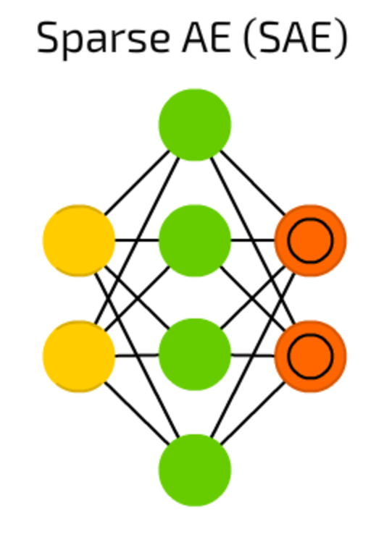
Sparse AE
SAE is yet another autoencoder type that in some cases can reveal some hidden grouping patters in data. Structure is the same as in AE but hidden cell count is bigger than input / output layer cell count.

Slide 56
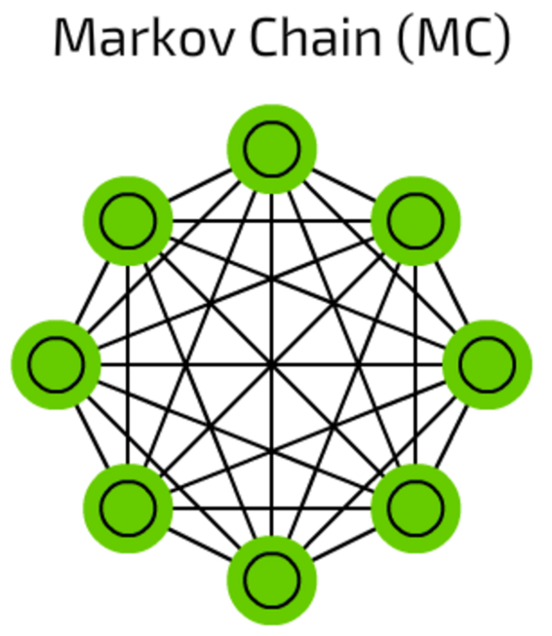
Markov Chains
Markov Chains are pretty old concept of graphs where each edge has a probability.
In old times they were used to construct texts like “after word hello we might have word dear with 0.0053% probability and word you with 0.03551% probability”.
This MCs are not neural networks in a classic way, MCs can be used for classification based on probabilities (like Bayesian filters), for clustering (of some sort), and as a finite state machine.

Slide 57
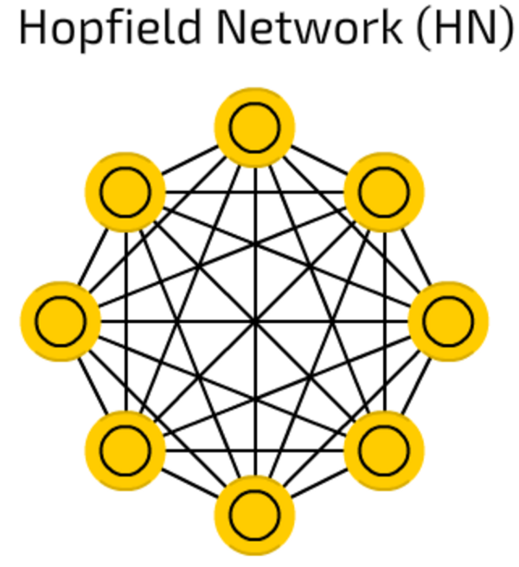
Hopfield networks
Hopfield networks are trained on a limited set of samples so they respond to a known sample with the same sample.
Each cell serves as input cell before training, as hidden cell during training and as output cell when used.
As HNs try to reconstruct the trained sample, they can be used for denoising and restoring inputs. Given a half of learned picture or sequence, they will return full sample.

Slide 58
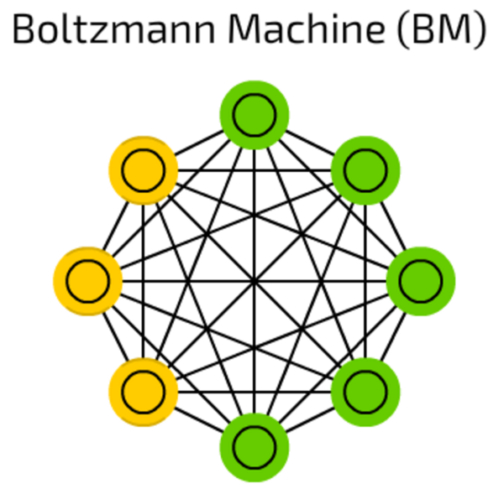
Boltzmann machines
Boltzmann machines are very similar to HNs where some cells are marked as input and remain hidden.
Input cells become output as soon as each hidden cell update their state.
Multiple stacked Boltzmann Machines can for a so-called Deep belief network (see below), that is used for feature

Slide 59
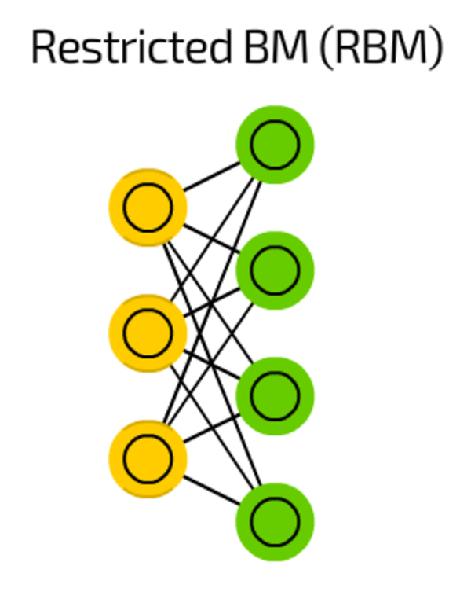
Restricted BM
RBMs resemble, in the structure, BMs but, due to being restricted, allow to be trained using backpropagation just as FFs (with the only difference that before backpropagation pass data is passed back to input layer once).

Slide 60
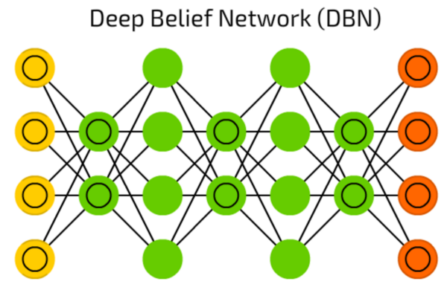
Deep Belief Network
DBNs, mentioned above, are actually a stack of Boltzmann Machines (surrounded by VAEs). They can be chained together (when one NN trains another) and can be used to generate data by already learned pattern.

Slide 61
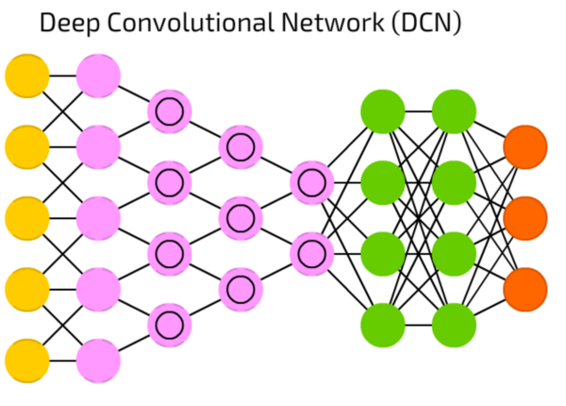
Deep Convolutional Network
DCN nowadays are stars of artificial neural networks. They feature convolution cells (or pooling layers) and kernels, each serving a different purpose.
Convolution kernels actually process input data, and pooling layers simplify, reducing unnecessary features.
Typically used for image recognition, they operate on small subset of image. The input window is sliding along the image, pixel by pixel. The data is passed to convolution layers, that form a funnel. From the terms of image recognition, first layer detects gradients, second lines, third shapes, and so on to the scale of particular objects.
DFFs are commonly attached to the final convolutional layer for further data processing.

Slide 62
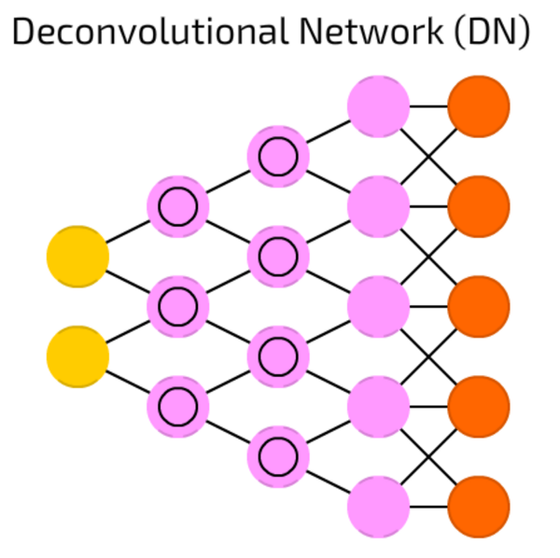
Deconvolutional Network
DNs are DCNs reversed. DN takes cat image, and produces vector like { dog: 0, lizard: 0, horse: 0, cat: 1 }. DCN can take this vector and draw a cat image from that. I tried to find a solid demo, but the best demo is on youtube.

Slide 63
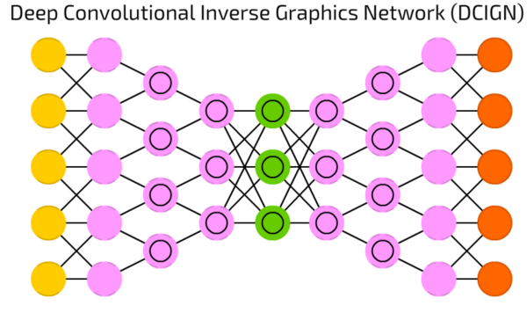
Deep Convolutional Inverse Graphics Network
DCIGN looks like DCN and DN glued together, but it is not quire correct.
Actually, it is an autoencoder.
DCN and DN do not act as separate networks, instead, they are spacers for input and output of the network.
Mostly used for image processing, these networks can process images that they have not been trained with previously.
These nets, due to their abstraction levels, can remove certain objects from image, re-paint it, or replace horses with zebras like the famous CycleGAN did.

Slide 64
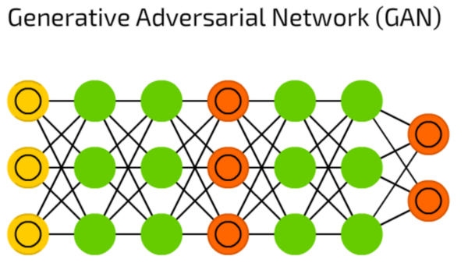
Generative Adversarial Network
GAN represents a huge family of double networks, that are composed from generator and discriminator.
They constantly try to fool each other — generator tries to generate some data, and discriminator, receiving sample data, tries to tell generated data from samples.
Constantly evolving, this type of neural networks can generate real-life images, in case you are able to maintain the training balance between these two networks.

Slide 65
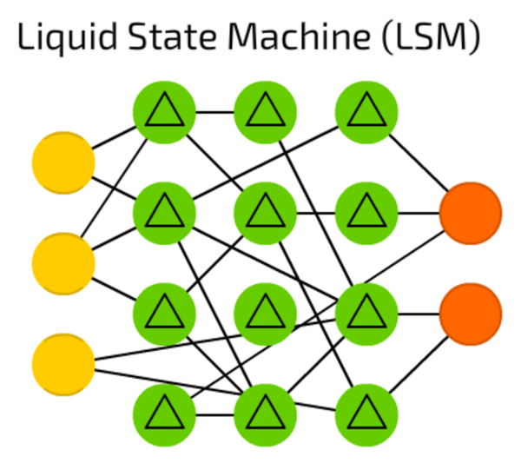
Liquid State Machine
LSM is sparse (not fully connected) neural network where activation functions are replaced by threshold levels.
Cell accumulates values from sequential samples, and emits output only when the threshold is reached, setting internal counter again to zero.
Such idea is taken from human brain, and these networks are widely used in computer vision and speech recognition systems, but without major

Slide 66
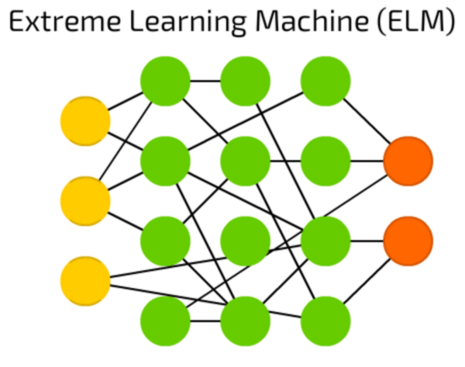
Extreme Learning Machine
ELM is an attempt to reduce complexity behind FF networks by creating sparse hidden layers with random connections. They require less computational power, but the actual efficiency heavily depends on the task and data.

Slide 67
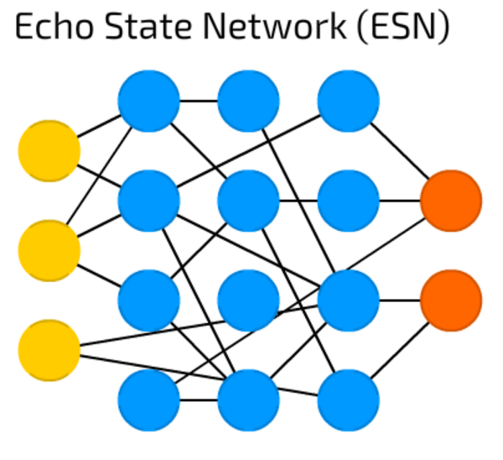
Echo State Network
ESN is a subtype of recurrent networks with a special training approach.
The data is passed to input, then the output if being monitored for multiple iterations (allowing the recurrent features to kick in).
Only weights between hidden cells are updated after that.

Slide 68
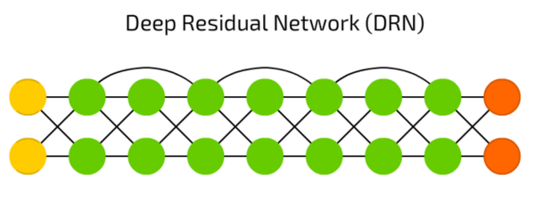
Deep Residual Network
DRN is a deep network where some part of input data is passed to next layers.
This feature allows them to be really deep (up to 300 layers), but actually they are kind of RNN without explicit delay.

Slide 69
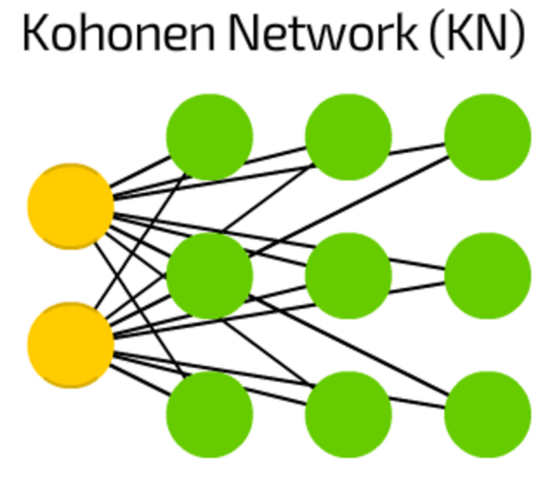
Kohonen Network
KN introduces the “distance to cell” feature. Mostly used for classification, this type of network tries to adjust their cells for maximal reaction to particular input. When some cell is updated, it’s closest neighbours are updated aswell.
Like SVMs these networks are not always considered to be a “real” neural networks.

Slide 70
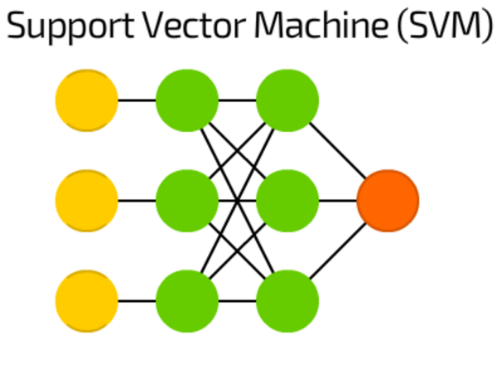
Support Vector Machine
SVM is used for binary classification tasks. No matter how many dimensions — or inputs — the net may process, the answer is always “yes” or “no”.
SVMs are not always considered to be a neural network.

Slide 71
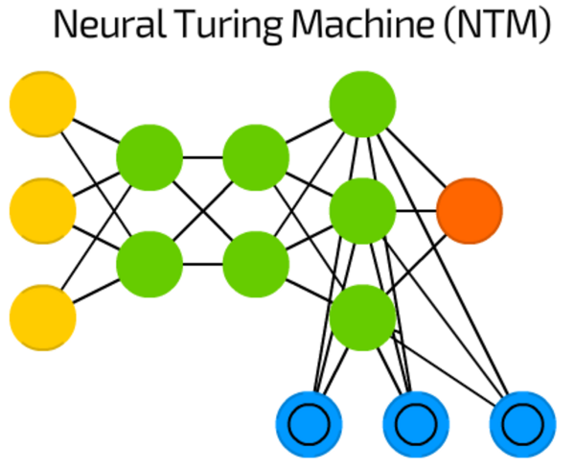
Neural Turing Machine
Neural networks are like black-boxes — we can train them, get results, enhance them but the actual decision path is mostly hidden from us.
The NTM is an attempt to fix it — is it a FF with memory cells extracted. Some authors also say that it is an abstraction over LSTM.
The memory is addressed by its contents, and the network can read from and write to the memory depending on current state, representing a Turing-complete neural network.

